Slide 1

Task 1: Web scraping to gain company insights
Presentation By : Parneet Kaur

Slide 2
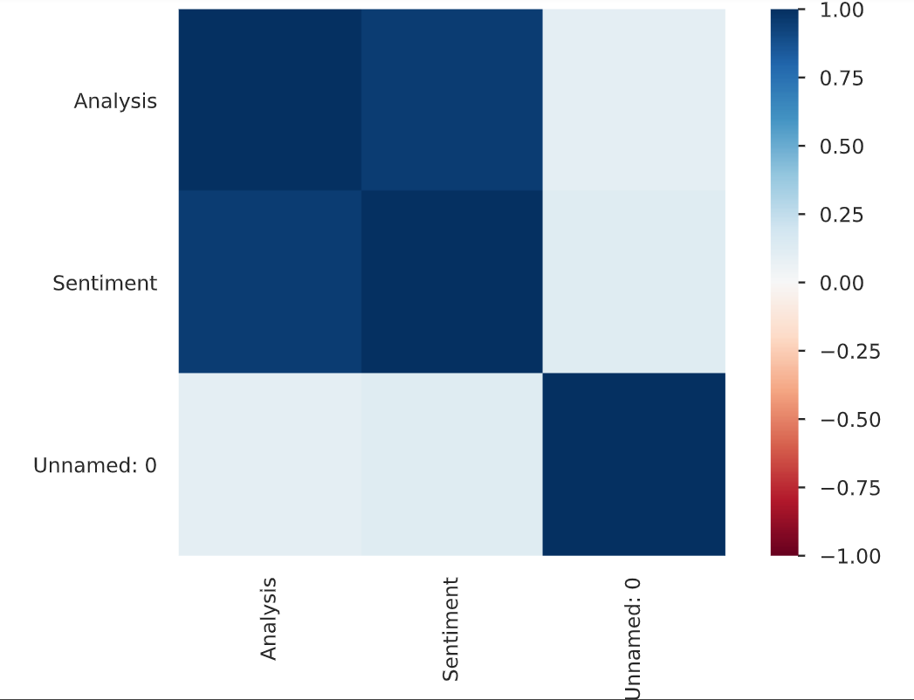
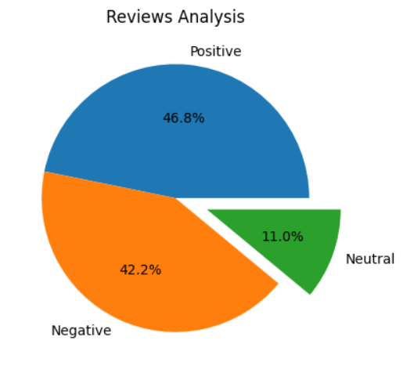
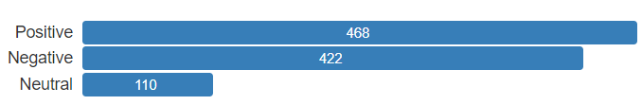
Correlation chart after Sentiment Analysis
Pie Chart of Reviews after Sentiment
Analysis
No. of Different Reviews After Cleaning

Slide 3
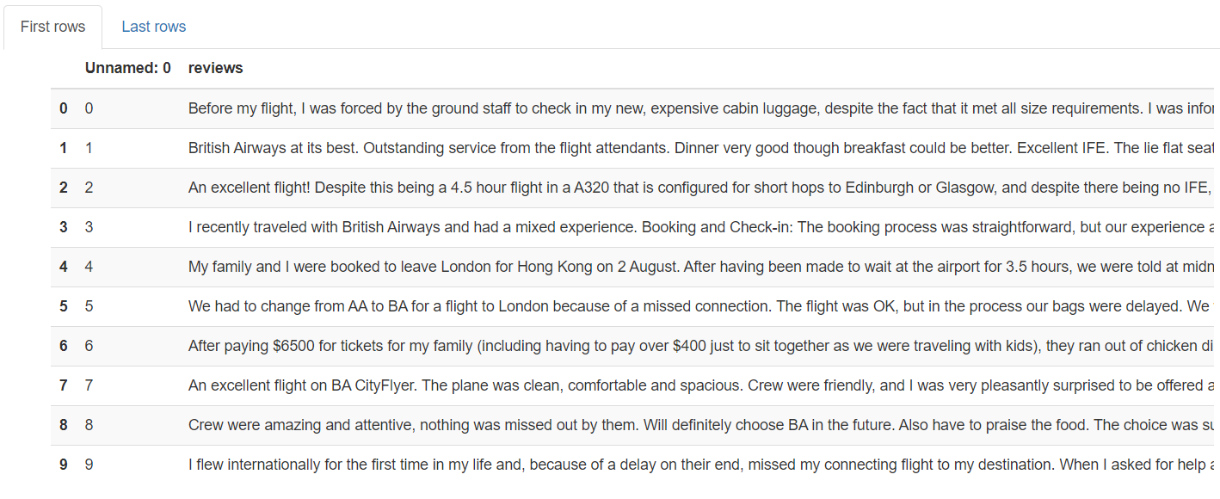
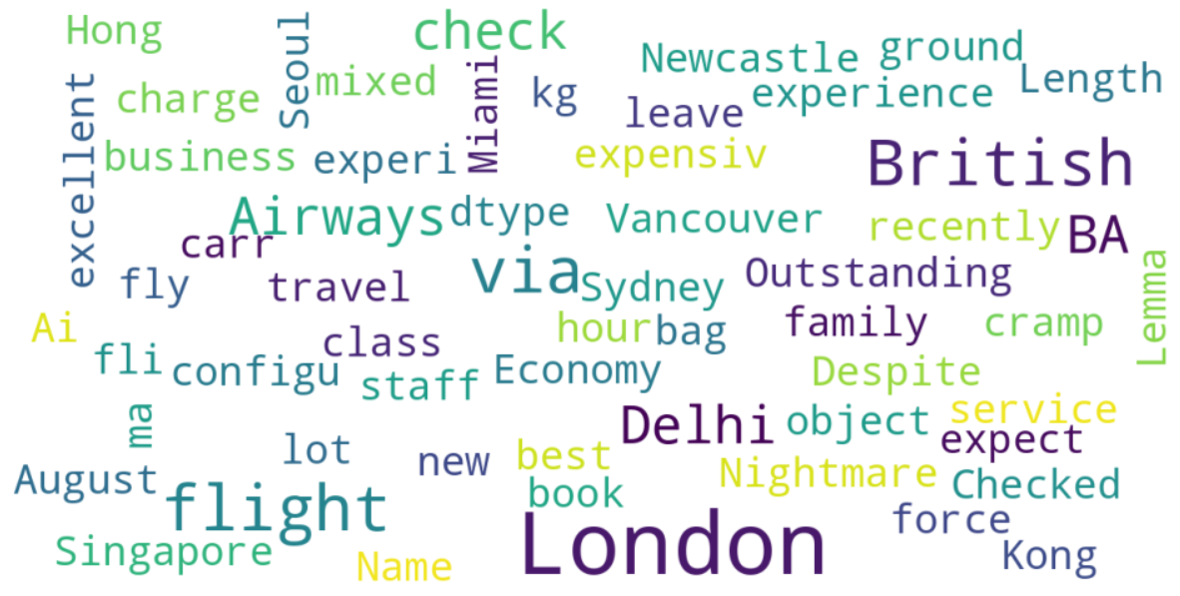
Head View of Cleaned Datasets
Most Frequent Keywords Used in Reviews

